Slide 1


Automatic License Plate Recognition System
Team members:
Project Guide: 1.Godwin vimal kumar.E- 510817104011
Ms.S.Vennilla,M.E 2.Prabhu.D - 510817104028
3.Prakash.H - 510817104030
INTERNAL EXAMINER
EXTERNAL EXAMINER

Slide 2
Objective:
The main goal of our project is to recognize the license plate of the vehicle.
Convert the digital image(License plate image) into plain text and store it in a csv file with the vehicle visited time and date.
We can also use in real-time traffic video with CCTV connectable.

Slide 3
Abstract:
Automatic license plate recognition technology is a authorization technology. It is based on capturing the number plate of the vehicle to the authorization purpose.
Manually it is very difficult to monitor the license plate of the car.
In order to avoid this issue the automatic license plate recognition system are used.
Experimental results are demonstrated using a traffic videos.

Slide 4
Introduction:
The vehicle license plate is recognizable proof of the vehicle to monitor.
This system introducing the multiline license plate recognition.
This system using opencv and Russian haar-cascades for vehicle detection, Tesseract(OCR) is used to recognize characters in the license plate.
This system was mainly used in toll gates, parking areas, traffic monitoring and access control.

Slide 5
Literature survey:
Author | Title | Proposed system | limitation
Joel J P C Rodrigues , Deepak Gupta | “Automatic vehicle license plate recognition using optimal K-means with convolutional neural network for intelligent transportation systems” IEEE access, vol 8,pp 92907-92917,16 apr 2020 | The proposed work presents an effective deep learning based VLPR Model using optimal K-means clustering based segmentation convolutional neural network | It is very difficult to implement
Ming Xiang He , Peng Hao | “Robust Automatic Recognition of Chinese License Plates in Natural Scenes” IEEE access, vol 8,pp 201317-201330,10 July 2020. | The proposed work using object detection algorithm to detect vehicle to detect LP LPD network LP recognition using LPR network | The detector is not well trained It detect only the Chinese number plate.
Ali Tourani Sajjad soroori | “A Robust Deep Learning Approach for Automatic Iranian Vehicle License Plate Detection and Recognition for surveillance systems” IEEE access, vol 8,pp 201223-271343,11 mar 2020 | The proposed system is mainly used in the driveway security gates | It uses different types of the data set to recognize the license plate

Slide 6
Continued..,
Author | Title | Proposed system | limitations
Jithmi Shashirangana; Heshan Padmasiri | “Automated License Plate Recognition: A Survey on Methods and Techniques” IEEE access, vol 5,pp 2169-3536,12 sep 2018 | The proposed system detect the license plate at any complex environment | It works only in the daytimes
Bedir bedir yousif ,Mohamed maher ata | Toward an Optimized Neutrosophic k-Means With Genetic Algorithm for Automatic Vehicle License Plate Recognition (ONKM-AVLPR) IEEE access ,vol 8,pp 49285-49312,17 jan 2017 | The proposed system achieves high degree of recognition accuracy for the whole system | It requires large memory to store the vehicle details
Lijuan Liu, Yanping Wang | “Image recognition technique based on machine learning” IEEE access, vol 7,pp 2169-3539,06 dec 2019. | which may improve the efficiency of non license plate recognition. | It is difficult to detect the license plate in the complex background

Slide 7
Existing system:
In previous license plate recognition system it only detect the number only in the license plate.
Disadvantage:
In previous system Canny and Morphological operator is used to detect the frontal view of the car it gives less accuracy.
It is tough to detect the rotated license plate of the vehicles.
It detect only single line license plate layout of the vehicle.

Slide 8
Proposed system
In proposed system Russian Haar Cascade is used to detect the vehicle. It achieves high accuracy.
Advantages:
It extract the license plate in the correct sequences using Russian Haar-cascade technique.
It will also detect rotated license plate of the vehicles plate.

Slide 9
Continued..,
This system recognize the double line license plates of the vehicle.
The license plate recognition in incorrect sequence it consider as wrong

Slide 10
System architecture:
Russian-Haar-Cascade
Input image
(video)
Image pre-processing
scikit- learn
(python library)
Tesseract
RGB to Gray scale image
Character segmentation
License plate extractions
Edge detection
Canny edge (opencv)
License plate recognition
Haar cascades
Output:
Display the recognized number plate in text

Slide 11
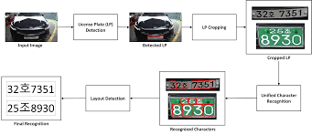
Workflow diagram:

Slide 12
Modules:
a)Vehicle detection
b)License plate detection
c)Unified character recognition
d)Store the data in CSV file

Slide 13
Modules Description:
a)Vehicle detection:
In this module we detect the vehicle image from the given input.
Russian Haar Cascade is a image processing Xml library it is used to detect the vehicle from the given input.
And the image converted into gray scale image using scikit-learn library.
Scikit-learn is one of the python library to convert RGB to gray scale image.

Slide 14
Russian haar cascade algorithm
The algorithm can be explained in four stages:
Calculating Haar Features
Creating Integral Images
Using Adaboost
Implementing Cascading Classifiers

Slide 15
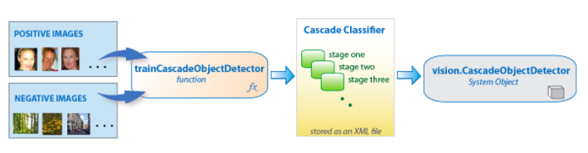
Working of Russian-haar-cascade

Slide 16
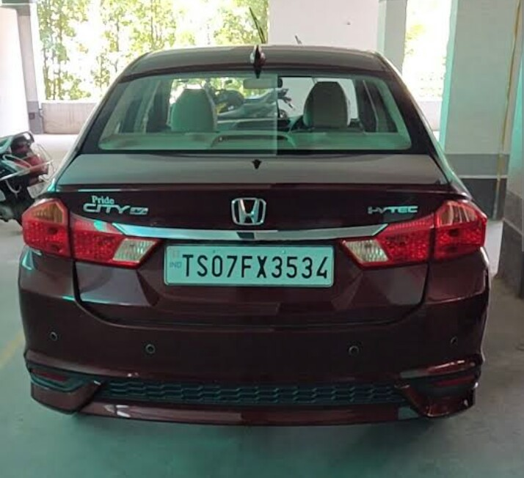
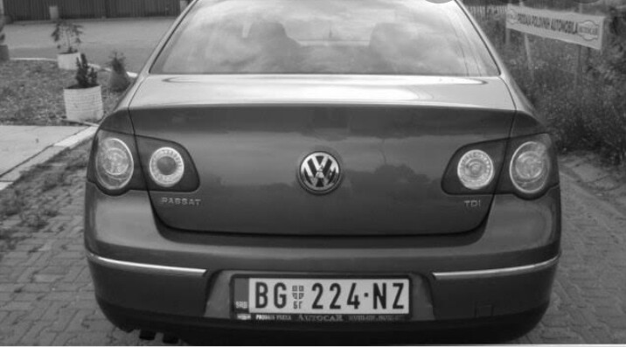
Original image
Gray scale image

Slide 17
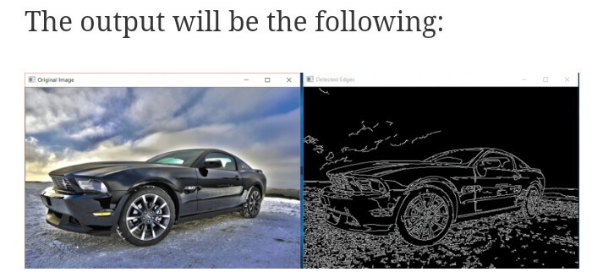
And detect the edges of the image using canny edge method from opencv.
Edge detection

Slide 18
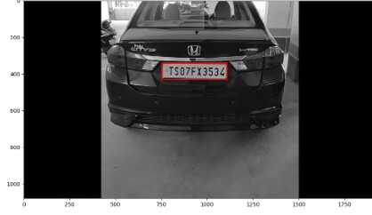
b)License plate detection:
In this module we detect the number plate from the given input.
Using the Haar-cascade algorithm is uses to detect and crop the number plate of the detected vehicle.

Slide 19
c)unified character recognition:
In this module there are two main tasks.
Character segmentation.
Character recognition.
In this module the character segmentation and character recognition is done by Tesseract OCR(Optical Character Recognition)
It provides clean segmentation of the character in the license plate.
Tesseract test the text lines to determine whether they are fixed pitch or not
If it is fixed pitch Tesseract chops the words into character using pitch.
Finally it send to the word recognition step.

Slide 20
d)Store the data in csv file
In this module the captured data are stored in the csv file using python.
Reading and writing CSV file using python
writer() this function in csv module return a writer object that convert data into a delimited string and stores in file object.
Writerow() this function writes items in an iterable (list, tuple, or string),separating them by comma character.

Slide 21
CSV modules
Some of the modules of CSV are
writerows()
read()
Dictwriter()
writeheader()
DictReader()

Slide 22
System requirements:
Requirement | Minimum | Recommended
RAM | 4 GB of free RAM | 8 GB of total system RAM
Disk space | 2.5 GB and another 1 GB for caches | SSD drive with at least 5 GB of free space
Monitor resolution | 1024x768 | 1920×1080
Operating system | 64-bit versions of Microsoft Windows 8 or 8.1 and Windows 10
Python 3: version 3.9.0

Slide 23
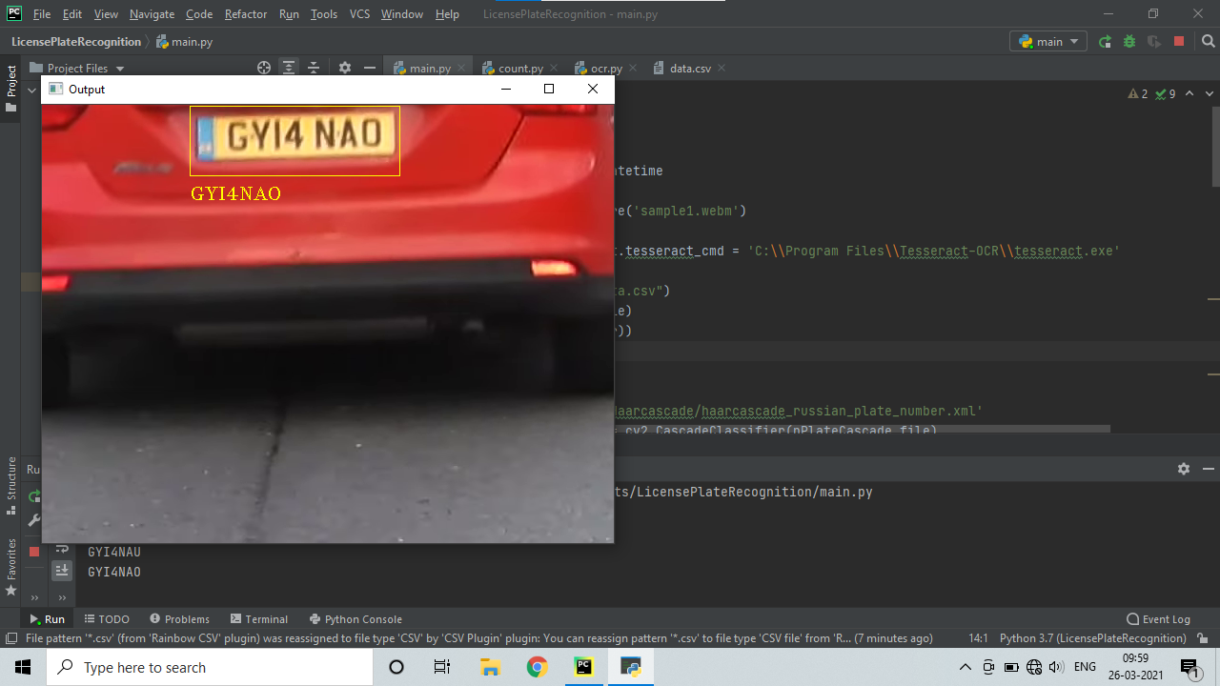
Output 1

Slide 24
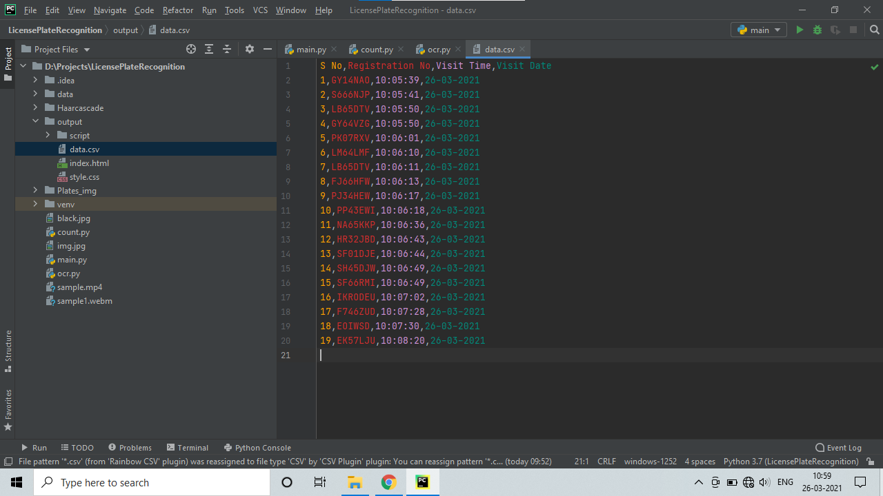
Output 2

Slide 25
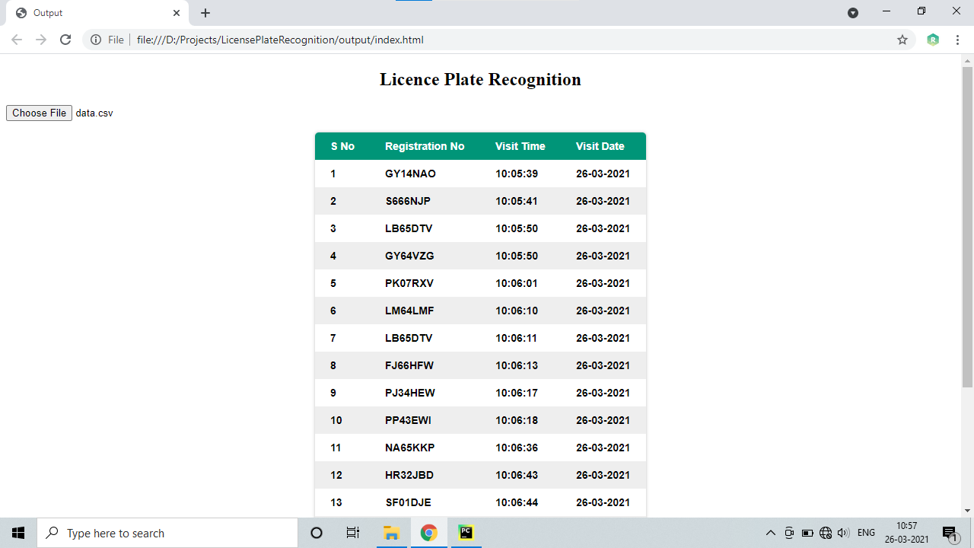
Output 3

Slide 26
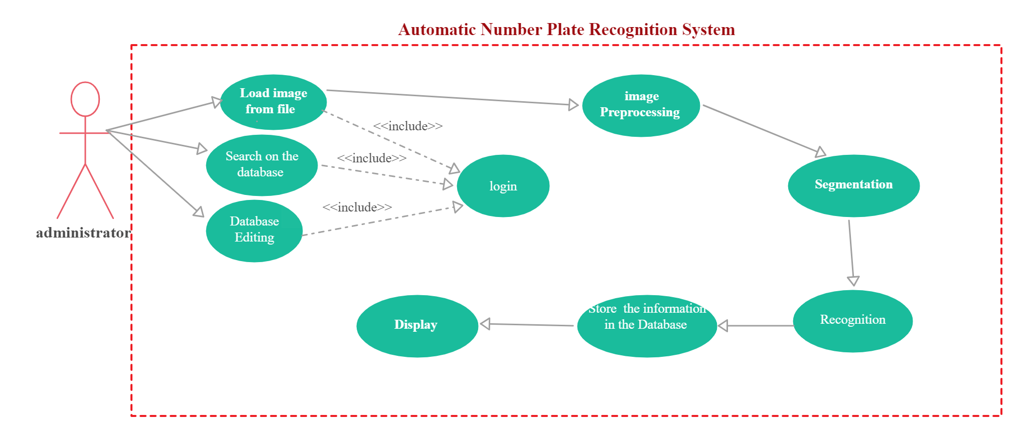
Use case diagram

Slide 27
Conclusion:
This technique is very efficient in detecting the vehicle number plate from videos of the vehicle using the Russian haar cascade algorithm.it is highly effective in security areas like border crossing, red lights, toll plaza and petrol stations etc., it shows number plate extracted from all images one by one automatically.

Slide 28
Future enhancement:
Future scope of this system to detect the multinational license plate from the different countries. because the vehicles are belonging from the different countries it is chance to escape from the security to avoid this to enhance the system to detect the multinational license plate is challenging work.

Slide 29
References:
1)CHRIS HENRY,SUNG YOON AHN-” License plate recognition using generalized character sequence detection ” –IEEE access, vol 8,pp 202345-234565,19 Feb 2020
2)ALI TOURAN, SAJJAD SOROORI “A Robust Deep Learning Approach for Automatic Iranian Vehicle License Plate Detection and Recognition for surveillance systems”-IEEE access, vol 8,pp 201223-271343,11 mar 2020.
3) JOEL J P C RODRIGUES,DEEPAK GUPTA “Automatic vehicle license plate recognition using optimal K-means with convolutional neural network for intelligent transportation systems ”-IEEE access, vol 8,pp 92907-92917,16 apr 2020.

Slide 30
Continued..,
4)BEDIR YOSIF , MOHAMAD MAHER ATA –” Toward an Optimized Neutrosophic k-Means With Genetic Algorithm for Automatic Vehicle License Plate Recognition (ONKM-AVLPR)”-IEEE access ,vol 8,pp 49285-49312,17 Jan 2017
5) JITHMI SHASHIRANGANA; HESHAN PADMASIRI-” Automated License Plate Recognition: A Survey on Methods and Techniques”-IEEE access, vol 5,pp 2169-3536,12 Sep 2018
6) LIJUAN LIU,YANPING WANG-” “Image Recognition Technique Based On Deep Learning”-IEEE access, vol 7,pp 2169-3539,06 dec 2019.

Slide 31
Thank you…

